Slide 1

Night
Character Map
Graphic Organizer

Slide 2
Directions
For each section (each slide has three sections), write one claim/conclusion, then include one or more supporting quotations from the text accompanied by a citation.
To receive credit on the character map, you must include at least one quotation with a citation. If you forgot to add citations (page numbers), you can easily find the page numbers by searching up your quote in the digital version of the text.

Slide 3
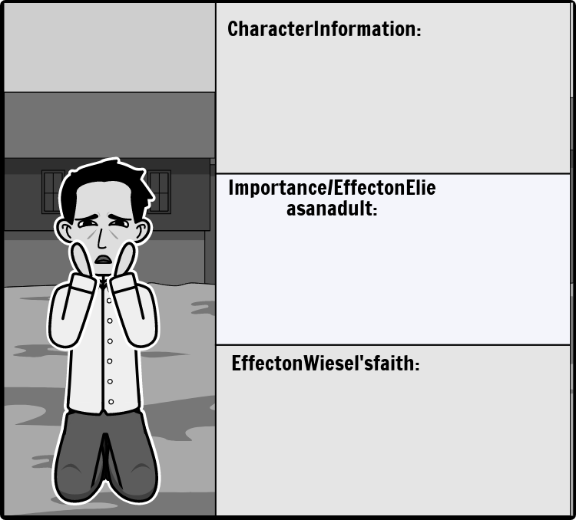
Akiba Drumer

Slide 4
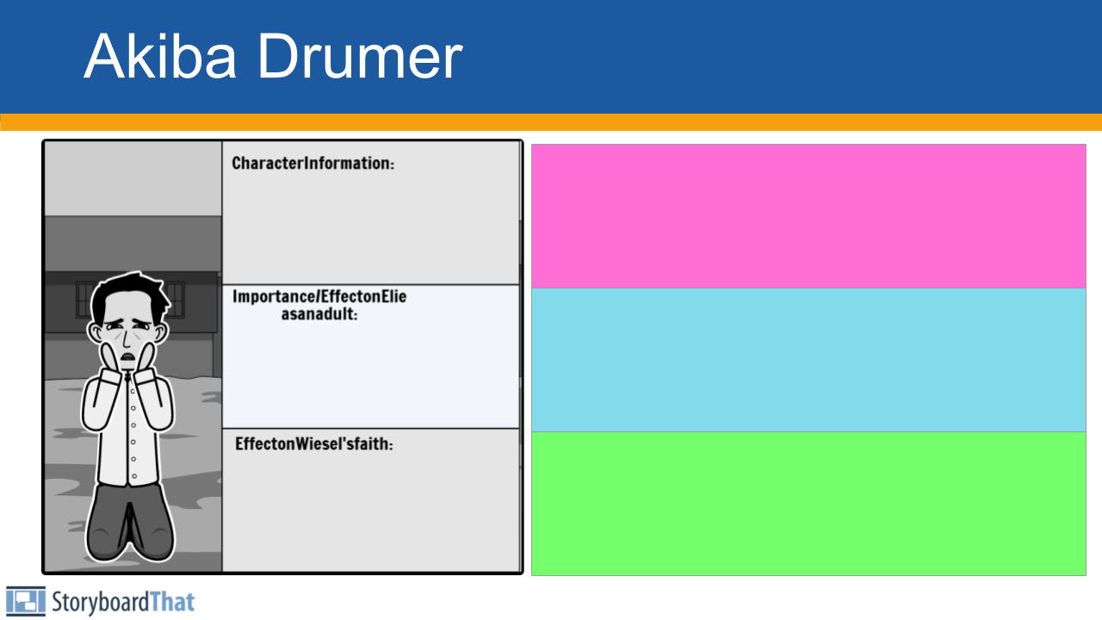
Side Boxes:
These are for observations and connections — not claims.
Character Info / Traits ➤ Who is the character? What do they do? What are they like?
Effect on Elie (as a child or adult) ➤ How does this character affect Elie emotionally, psychologically, or morally?
Effect on Wiesel’s Faith ➤ How does this character’s experience or behavior shape Elie’s beliefs about God?
These don’t need to be “arguments” — they are insights, patterns, or lessons that you notice. You’re just writing down what you see or think is important.

Slide 5
Main Claim + Quote Section:
Do not just drop a quote. Write a complete sentence that makes a point. Then support your point with a quote and citation.
Make a claim about the character — what they do, represent, or show.
Support it with a quote from the text that proves your claim.
Include a citation (Wiesel __).
Make a claim about the character — what they do, represent, or show.
Support it with a quote from the text that proves your claim.
Include a citation (Wiesel __).
Make a claim about the character — what they do, represent, or show.
Support it with a quote from the text that proves your claim.
Include a citation (Wiesel __).

Slide 6
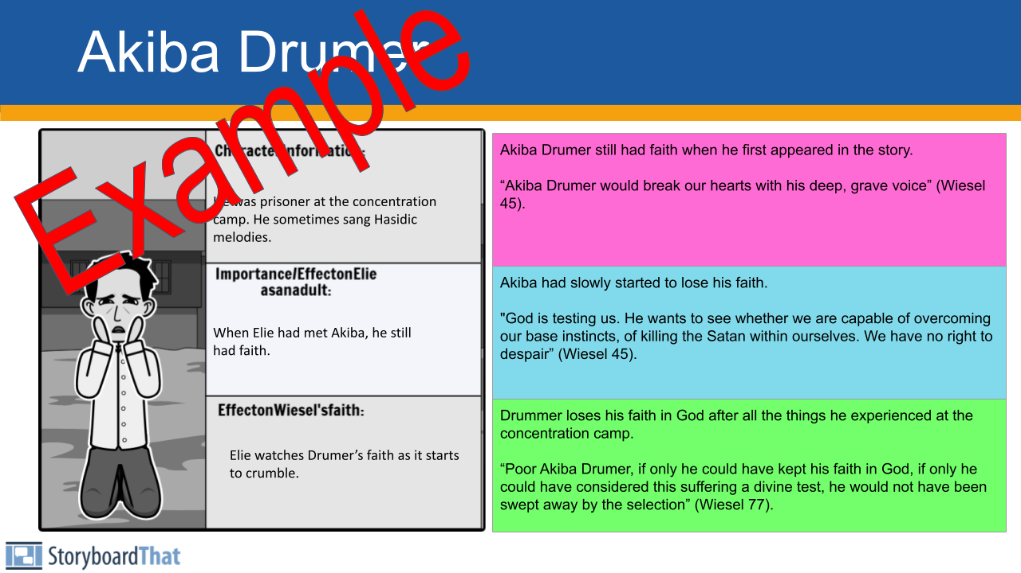

Slide 7
Character Index
1. Moishe the Beadle (p. 3-8)
2. Hilda (p. 4, 8)
3. Bea (p. 4)
4. Tzipora (p. 4, 19)
5. Eliezer
6. Malka (p. 7)
7. Tobie (p. 7)
8. Moishe Chaim Berkowitz (p. 9)
9. Mrs. Kahn (p. 10)
10. Ezra Malik (p. 12)
11. Stern (p. 12, 37)
12. Batia Reich (p. 14)
13. Uncle Mendel (p. 20)
14. Maria (p. 20)
15. Mrs. Schächter (p. 24-28)
16. Béla Katz (p. 35)
17. Yehiel (p. 36)
18. Stein (p. 43-45)
19. Reizel (p. 43-45)
20. Akiba Drumer (p. 45, 51, 76)
21. Hersh Genud (p. 45)
22. Juliek (p. 49, 61-62, 93-95)
23. Louis (p. 49)
24. Hans (p. 49)
25. Franek (p. 49, 55-56)
26. Idek (p. 50, 53, 54, 56-58)
27. Yossi (p. 50, 71-72)
28. Tibi (p. 50, 71-72)
29. Alphonse (p. 51)
30. Zalman (p. 86)
31. Rabbi Eliahu (p. 90-91)
32. Meir Katz (p. 37, 102-103)

Slide 8
Slide Completion Schedule
Eliezer (Elie) Wiesel (Elie’s Faith at the Beginning of The Novel (Chapter 1: pre-Holocaust)): N/A
Moishe the Beadle: 9/12
Idek: 9/12
Franek: 9/12
Tibi & Yosi: 9/19
Eliezer (Elie) Wiesel (Elie’s Faith at the Middle of The Novel): 9/19
Juliek: 9/26
Eliezer (Elie) Wiesel (Elie’s Faith at the End of The Novel): 9/26
Rabbi Eliahou: 10/17
Elie's Father (Shlomo Wiesel): 10/17
DUE: 10/24

